Slide 1
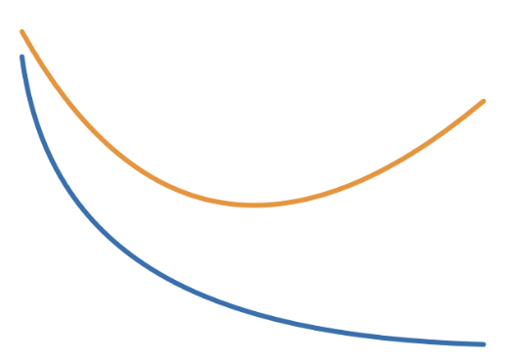
The Learning Curves
Validation
Loss
Training
Epochs

Slide 2

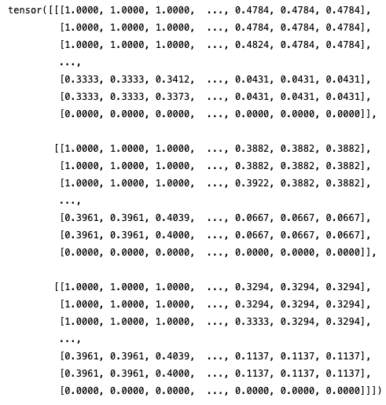


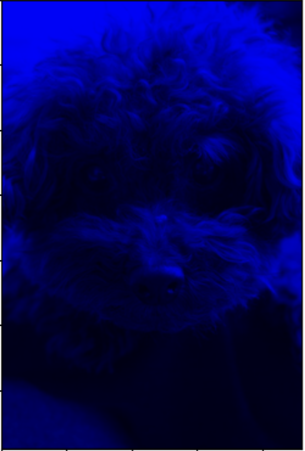

A
B
From
 | A | B | C | D
A |  | 1 | 1 | 0
B | 1 |  | 1 | 0
C | 1 | 1 |  | 1
D | 0 | 0 | 1
A
 | A | B | C | D
A |  | 0 | 1 | 0
B | 1 |  | 0 | 0
C | 0 | 1 |  | 1
D | 0 | 0 | 0
A
To
B
B
C
D
C
D
A
B

Slide 3
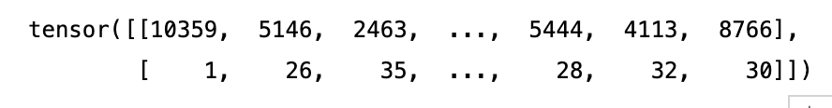




 | A | B | C | D
A |  | 1 | 1 | 0
B | 1 |  | 1 | 0
C | 1 | 1 |  | 1
D | 0 | 0 | 1
 | A | B | D | C
A |  | 1 | 0 | 1
B | 1 |  | 0 | 1
D | 0 | 0 |  | 1
C | 1 | 1 | 1
 | A | C | B | D
A |  | 1 | 1 | 0
C | 1 |  | 1 | 1
B | 1 | 1 |  | 0
D | 0 | 1 | 0
 | A | D | B | C
A |  | 0 | 1 | 1
D | 0 |  | 0 | 1
B | 1 | 0 |  | 1
C | 1 | 1 | 1
A
B
 | A | C | D | B
A |  | 1 | 0 | 1
C | 1 |  | 1 | 1
D | 0 | 1 |  | 0
B | 1 | 1 | 0
 | A | D | C | B
A |  | 0 | 1 | 1
D | 0 |  | 1 | 0
C | 1 | 1 |  | 1
B | 1 | 0 | 1
 | B | A | C | D
B |  | 1 | 1 | 0
A | 1 |  | 1 | 0
C | 1 | 1 |  | 1
D | 0 | 0 | 1
 | B | A | D | C
B |  | 1 | 0 | 1
A | 1 |  | 0 | 1
D | 0 | 0 |  | 1
C | 1 | 1 | 1
C
D
A. Edge Label Index
B. Edge Label
Nodes
[ 1 , 0 , 0 , 0 , 1 , 1 , 0 ]
Edges
[ 0 , 1 , 1 , 1 , 1 , 0 , 0 , 0 ]
Adjacency List
[ [ 0 , 1 ] , [ 1 , 2 ] , [ 1 , 3 ] , [ 2 , 3 ] , [ 2 , 6 ] , [ 3 , 4 ] , [ 3 , 5 ] , [ 5 , 6 ] ]
A
B
E
C
D
G
F
a
B
B
A
B
C
D
b
E
F
c
B

Slide 4
B Embedding
A Linear Transformation
C Concatenation
1
2

